Slide 1
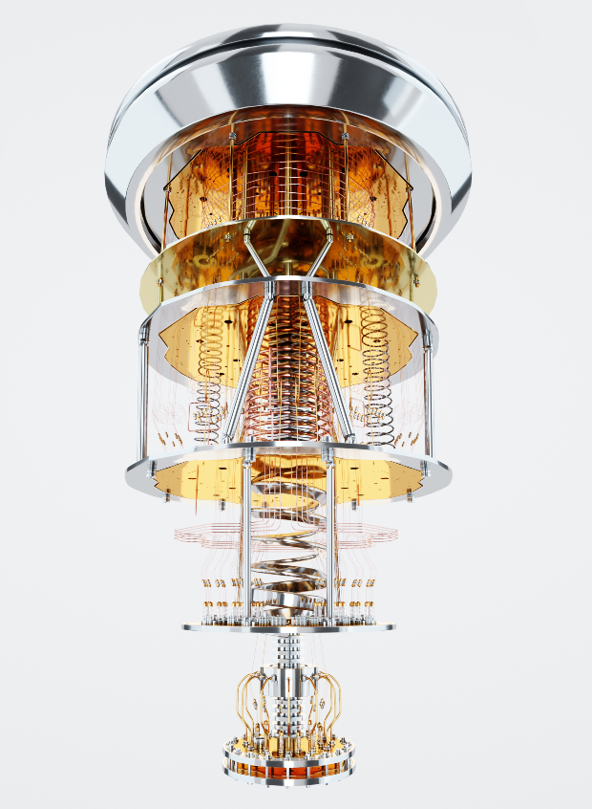

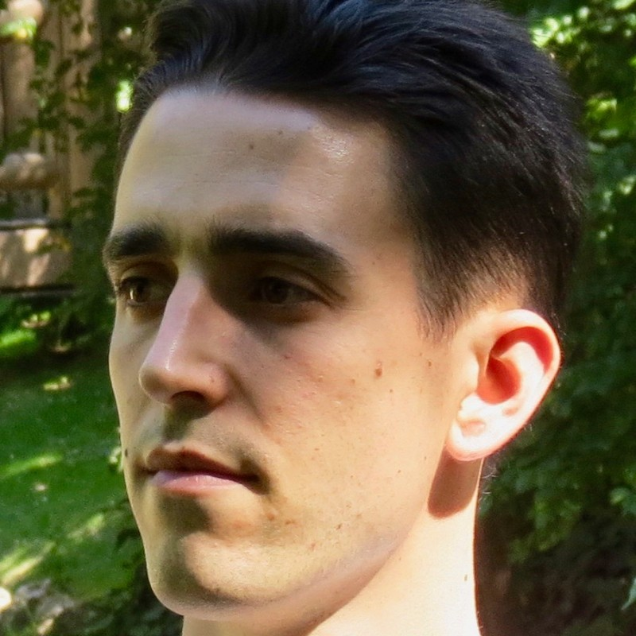
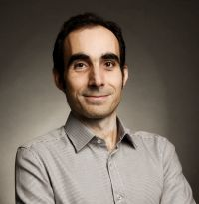


Transmission Expansion Planning by Quantum Annealing
A thesis submitted in fulfilment of the requirements for the degree of Master in Quantum Computing at Nebrija University.
1,3
2
3
Sergio López Baños
Dr. Álvaro Díaz Fernández
Dr. Oriol Raventós Morera
MSc Student
Academic Supervisor
Industry Supervisor
Source: Mckinsey Quantum Technology
Monitor April 2023
3
2
1

Slide 2
| Contents>
Motivation
Statement of the problem
Heuristic Methods
Simulated Annealing
Quantum Annealing
Resolution of Small Network
Hybrid Solver
Benders’ Decomposition algorithm
Conclusions and Future Work

Slide 3
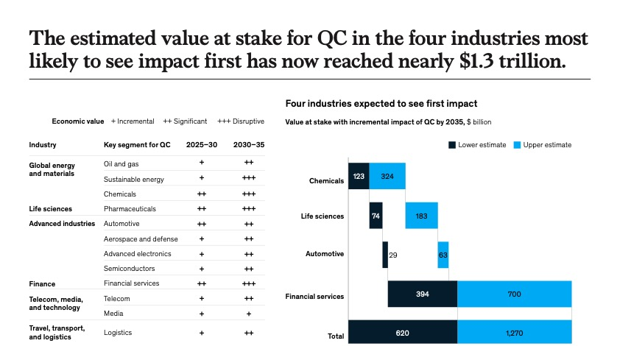
Source: Mckinsey Quantum Technology
Monitor April 2023
Motivation

Slide 4
Source: Mckinsey Quantum Technology
Monitor April 2023
Motivation

Slide 5
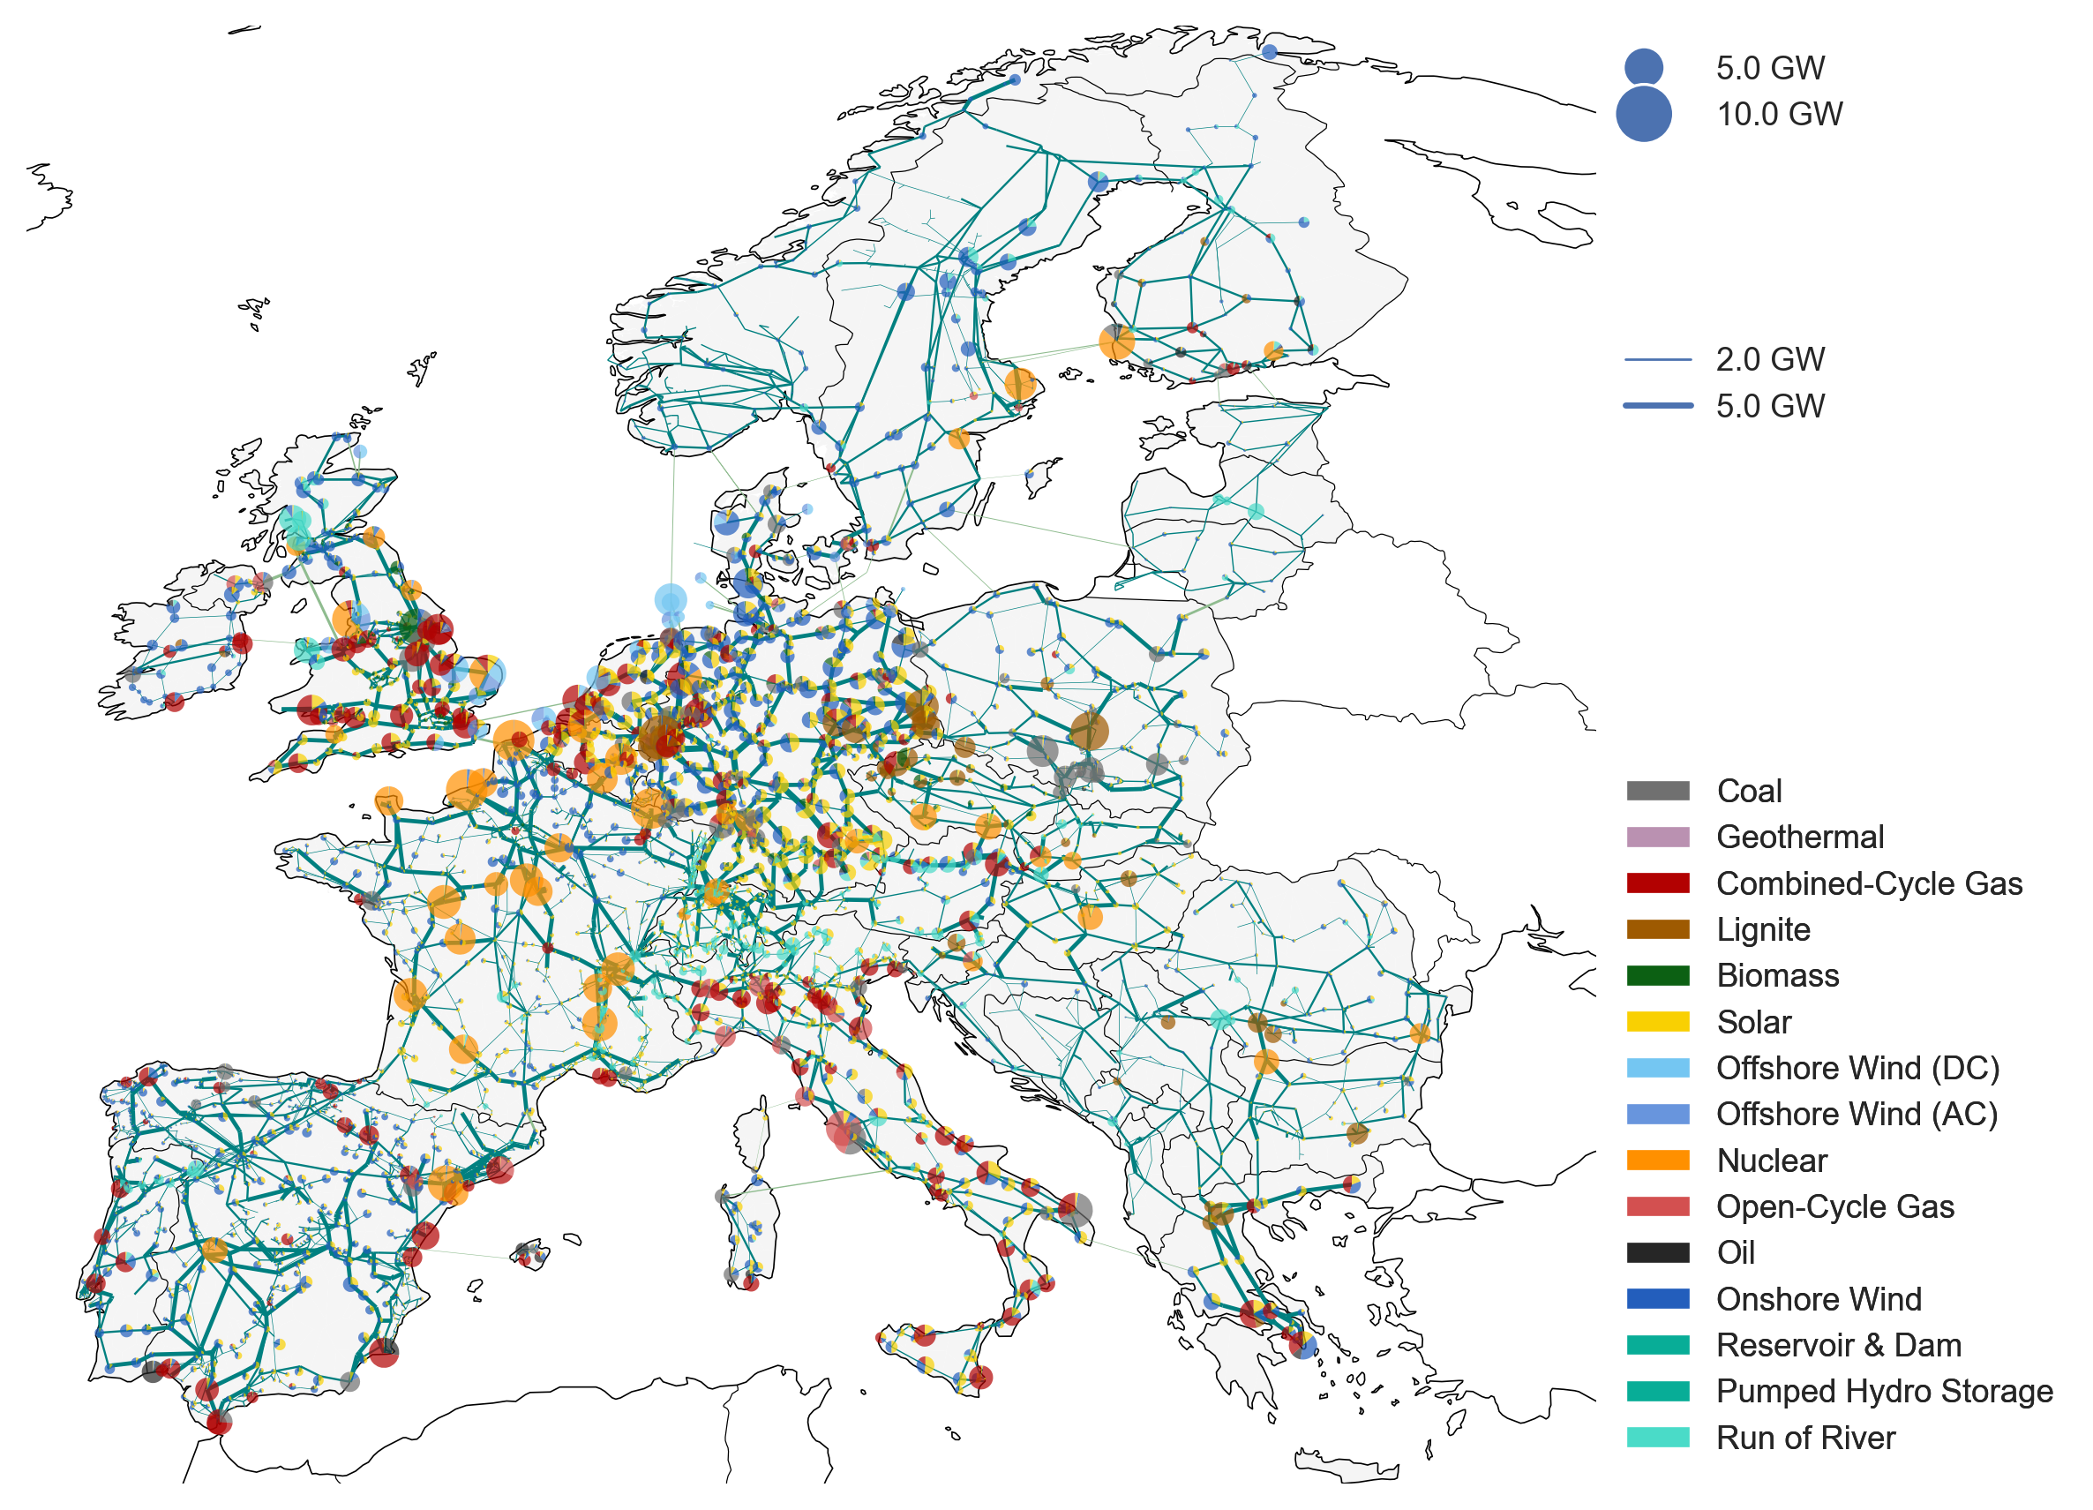
| Statement of the Problem>
Objective: distribute the energy across a network in the most effective way so that we minimize the energy loss.
Background: the smart grid provide data about the current status of the grid. There are predictions of future scenarios where the demand at each node is predicted and the network has to be able to fulfil the demand.
How: there are many ways of improving the efficiency of a network but we focus on the transmission expansion planning (TEP) problem. TEP aims at finding the optimal way of expanding the network by adding new lines between nodes.
Motivation: energy system models are getting larger and more complex due to the integration of decentralized weather-dependent renewable energy sources, intermittent loads, sector coupling and the increase of storage components.
Statement of the problem

Slide 6
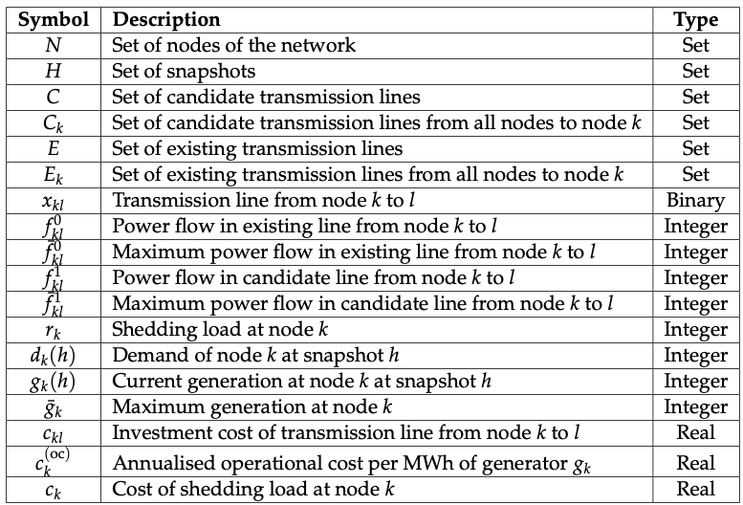
| Statement of the Problem>
Table 4.1: Description of variables involved in TEP problems.
Statement of the problem

Slide 7
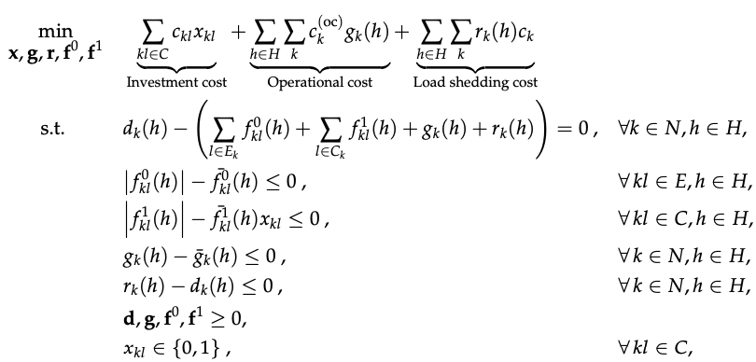
| Statement of the Problem>
(Power Balance)
(Existing circuit flow limits)
(Candidate circuit flow limits)
(Node generation limits)
(Node loads limits)
(Positive variables)
(Binary type)
Statement of the problem

Slide 8
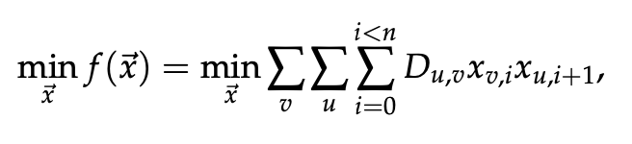
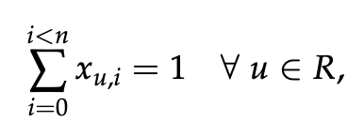
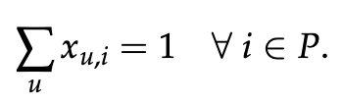
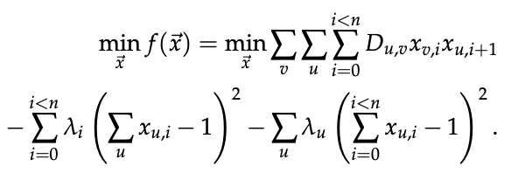
Heuristic Methods: | Simulated Annealing >
Objective function:
Travelling Salesman Problem
Visit each node just once in the whole path:
Each stop of the tour has one node:
Constrains in cost function by Lagrange multipliers:
Simulated Annealing

Slide 9
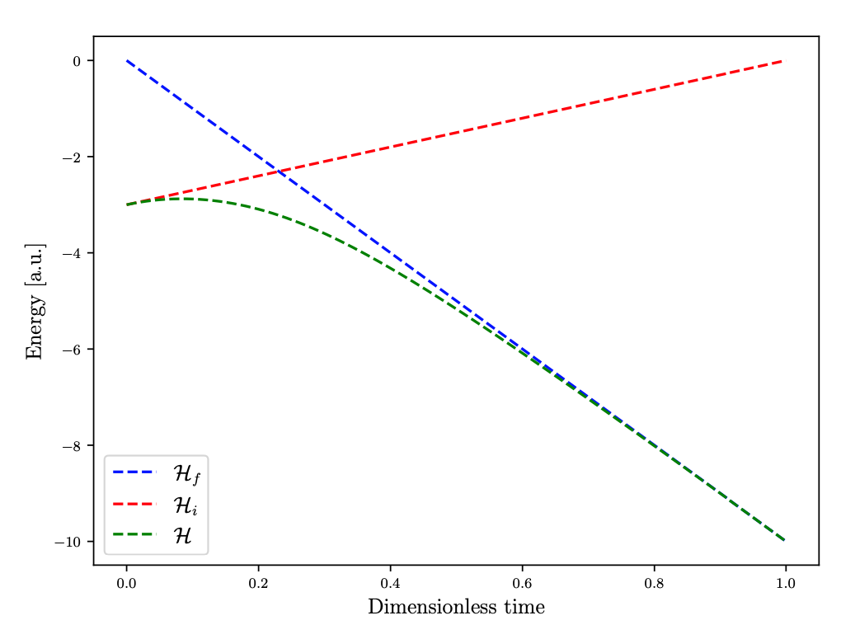
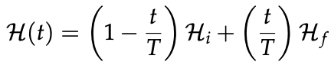
Heuristic Methods: | Quantum Annealing>
Interpolation of initial and final Hamiltonians:
Eigenenergies as function of dimensionless time:
Quoting Sarandy and Lidar:
The theorem posits, roughly, that if a state is an instantaneous eigenstate of a sufficiently slowly varying Hamiltonian at one time, then it will remain an eigenstate at later times, while its eigenenergy evolves continuously.
Quantum Annealing

Slide 10
TEP: | Small Network>
Brownfield model: Network considering current transmission lines (solid lines) and candidate lines (dashed lines).
Greenfield model: Network considering just candidate lines
(dashed lines).
Resolution of Small Network

Slide 11
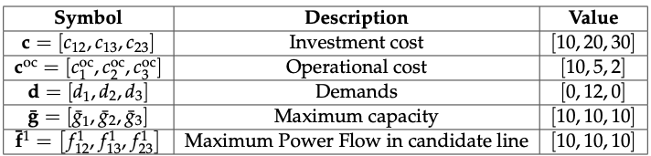
TEP: | Small Network>
Single demand at node 2.
One time snapshot.
Maximum capacity per generator 10 units of energy.
The demand cannot be fulfilled by its own generator and it requires to build at least one transmission line.
Table 4.2: Investment cost, operational cost, demand, maximum capacity per generator and maximum power flow per candidate line for a three node network.
Resolution of Small Network

Slide 12
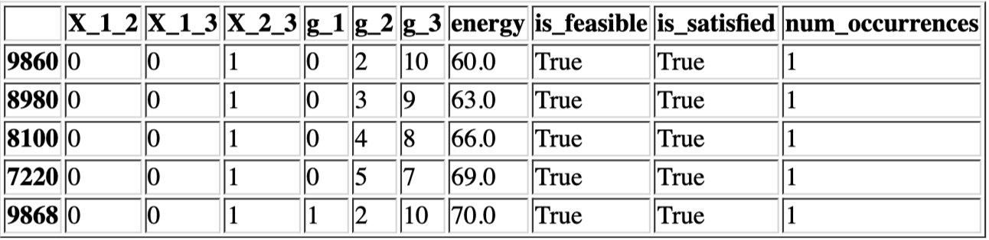
TEP: | Small Network>
Results:
Indicates that the constraints are fulfilled.
The solution that minimizes the objective cost – which is the sum of investment cost and operational cost – decides to build the transmission line connecting node 3 and 2 (the most expensive one) and use the generator 3 to produce most of the required energy (the cheapest operational cost)
Table 4.2: Investment cost, operational cost, demand, maximum capacity per generator and maximum power flow per candidate line for a three node network.
Resolution of Small Network

Slide 13
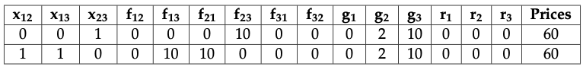
TEP: | Hybrid Solver>
LeapHybridCQMSampler
Main features:
20 min of free trial.
Solve MILP problems.
Cannot know how much quantum solver was involved in the resolution.
Hybrid Solver

Slide 14
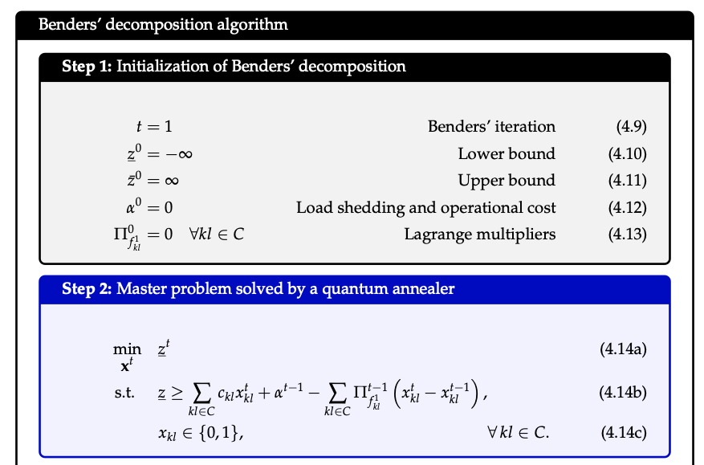
Quantum-Classical Iterative Method | Benders’ decomposition algorithm >

Slide 15
Quantum-Classical Iterative Method | Benders’ decomposition algorithm >

Slide 16
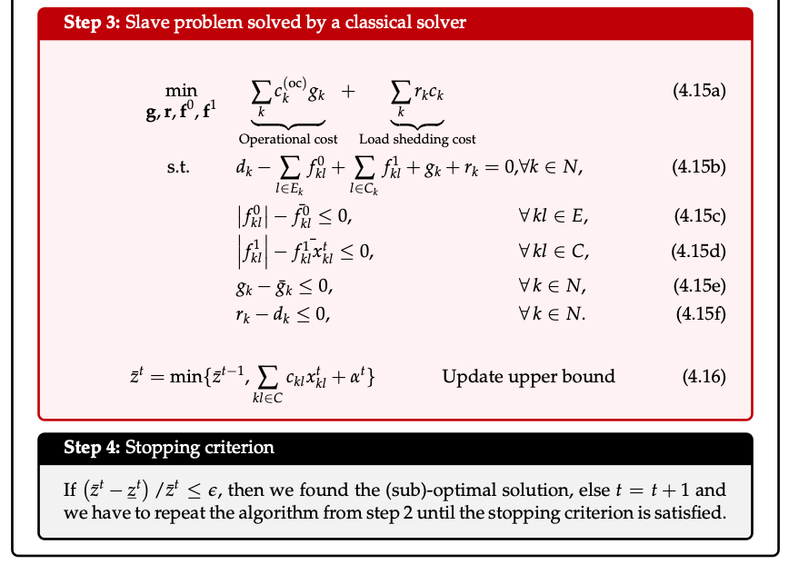
Quantum-Classical Iterative Method | Benders’ decomposition algorithm >
(
)

Slide 17
Quantum-Classical Iterative Method | Benders’ decomposition algorithm >

Slide 18
Quantum-Classical Iterative Method | Benders’ decomposition algorithm >
(
)
Benders’ decomposition algorithm

Slide 19
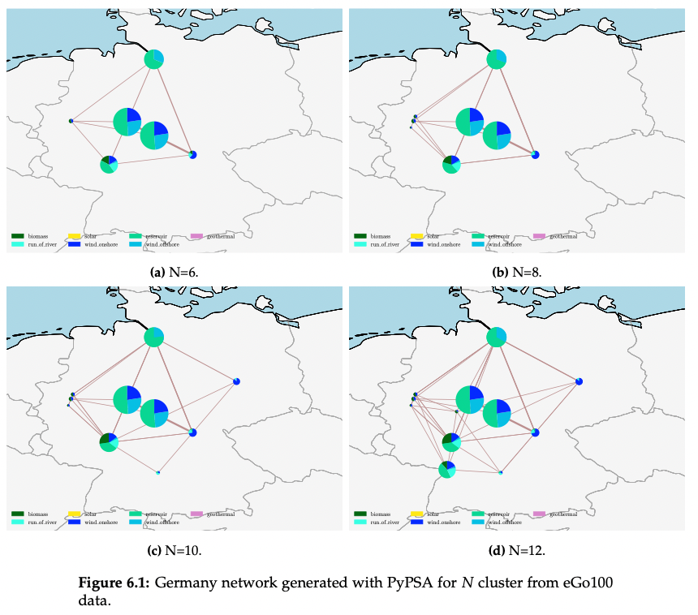
| Conclusions and Future Work>
PyPSA: this python package will read the raw data and produce the linear model files .lp
QUARK: this python package will reformulate the problem so that it can be sent to different quantum machines (hardware agnostic).
Benchmarking: once we have the interface to load the data and formulate the problem we can send it to different quantum machines and compare our hybrid quantum-classical method with those provide by companies such as D-Wave.
We expect that an specific hybrid quantum-classical model should work better than a general hybrid method. Furthermore, we will know exactly the amount of quantum solver employed.

Slide 20
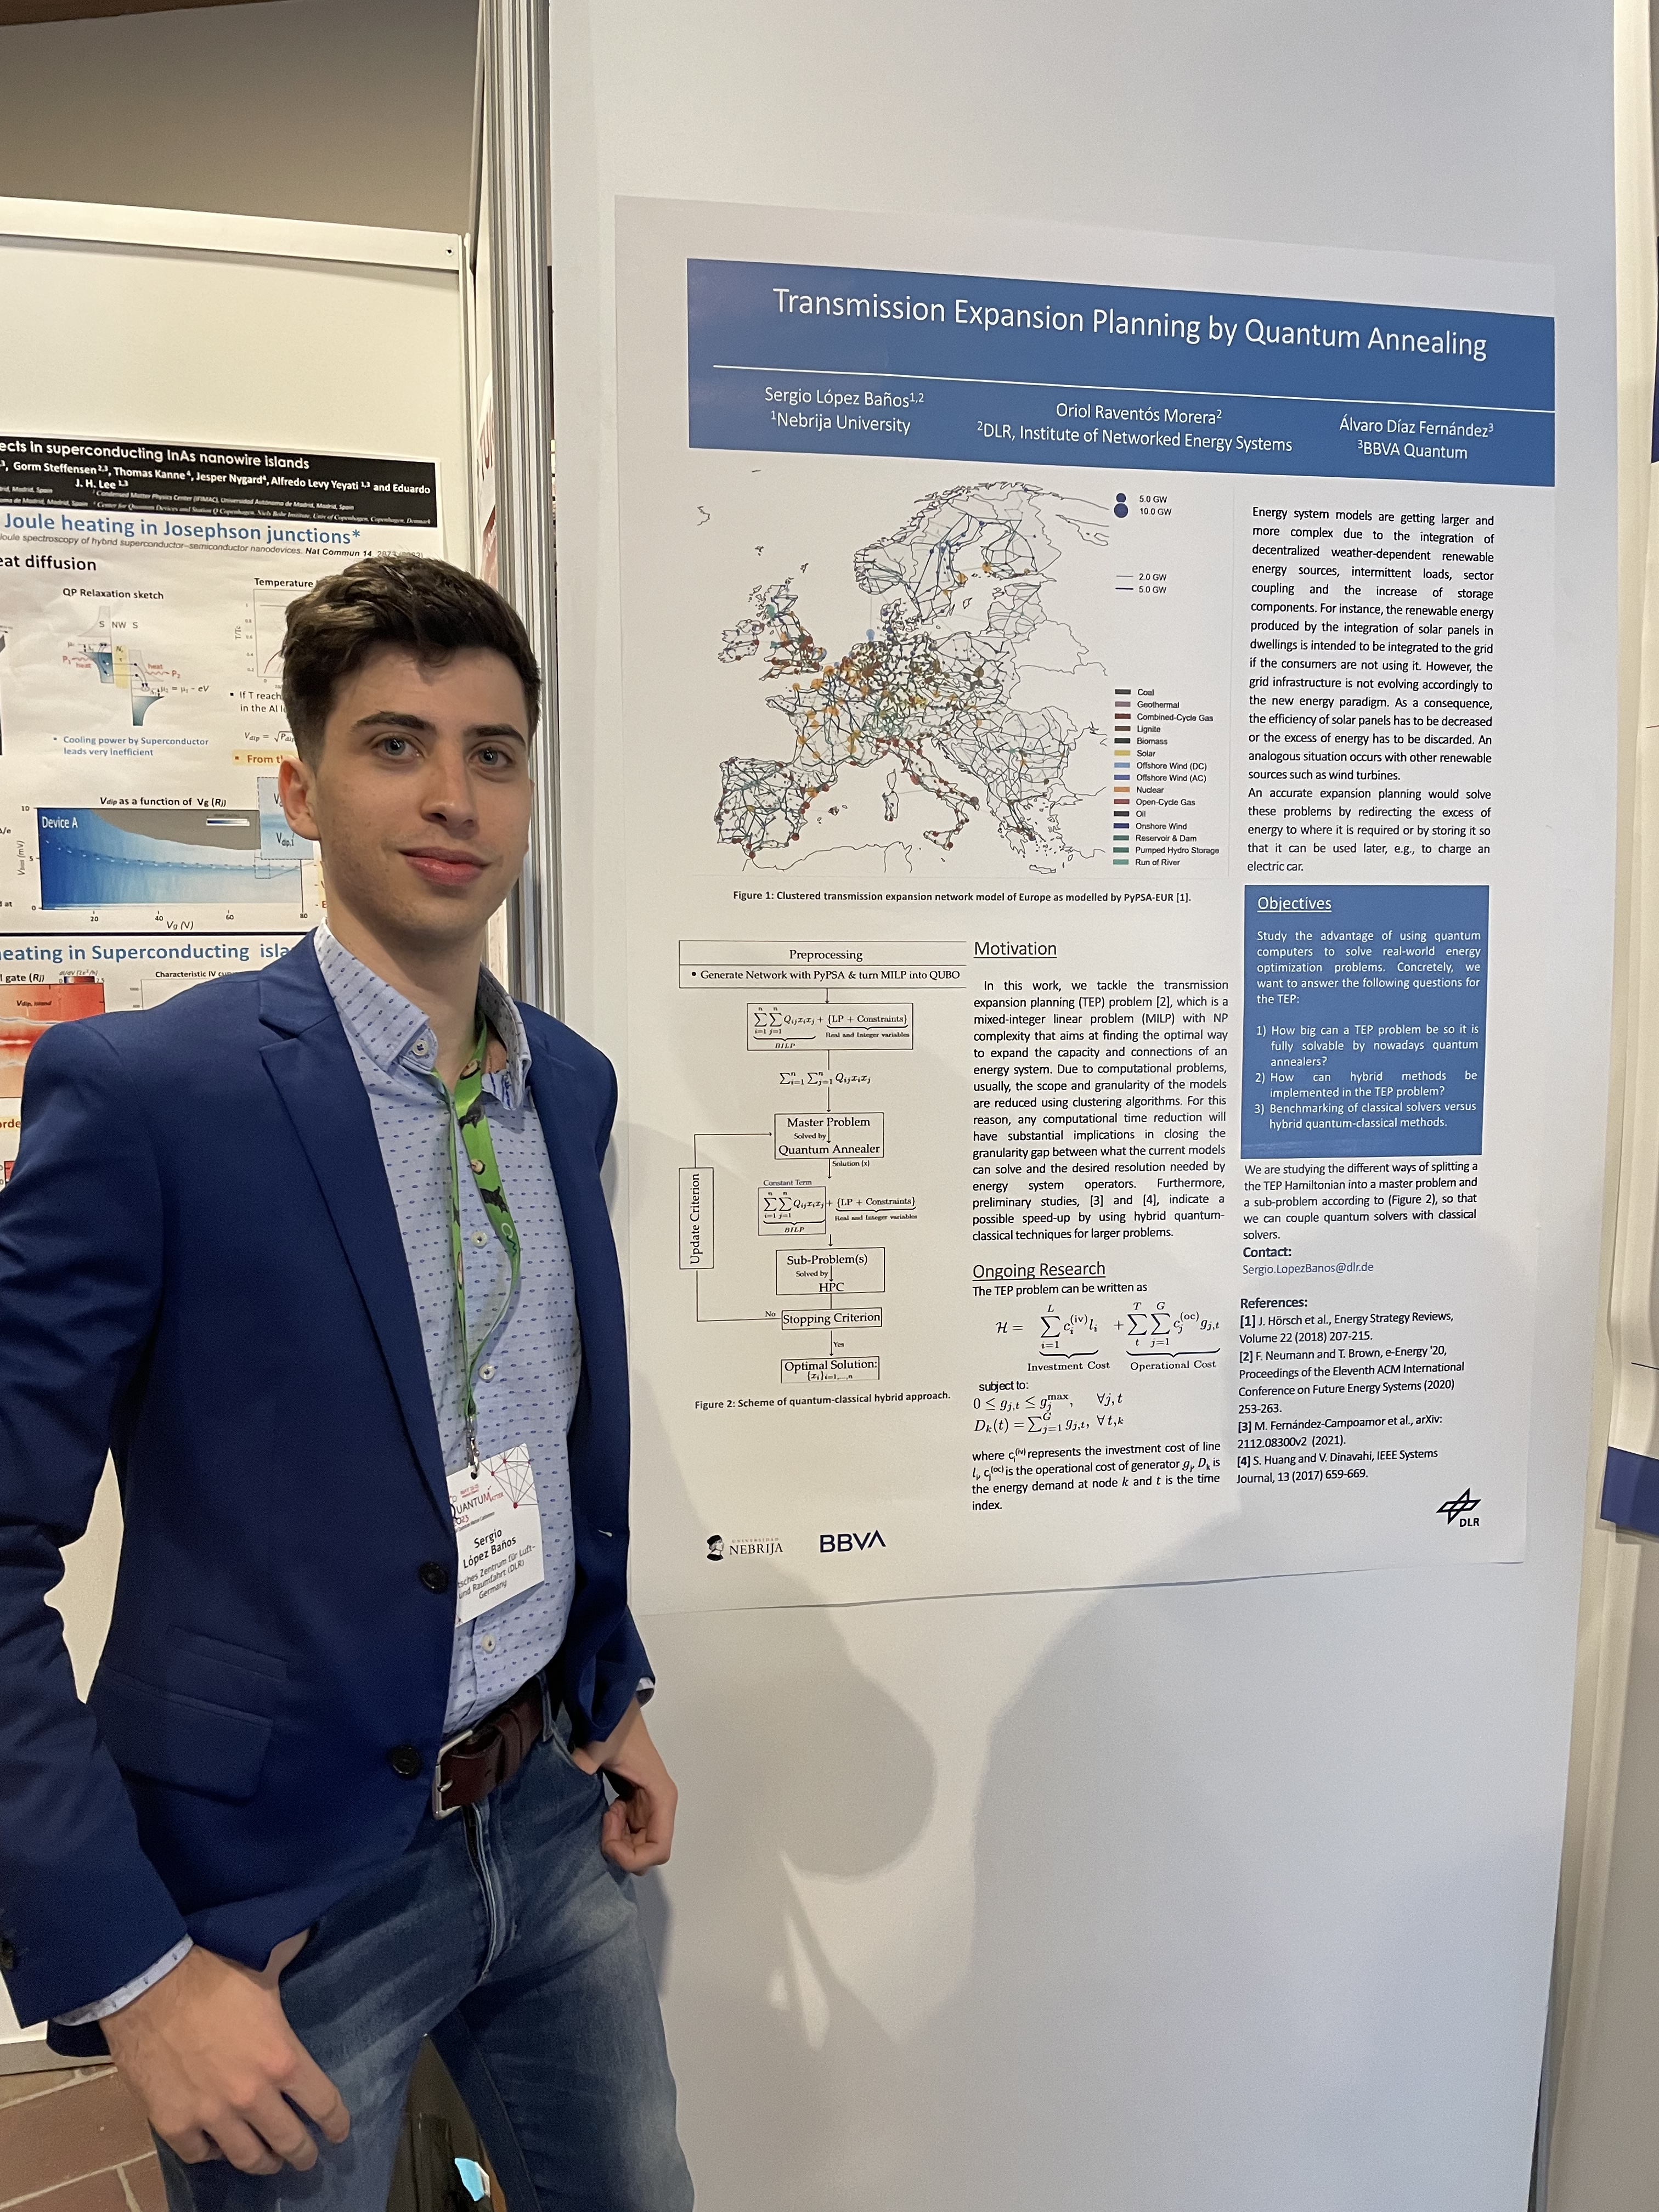
Thank you for your time
QUANTUMatter2023 Conference: Poster presentation titled “Transmission Expansion Planning by Quantum Annealing”.

